Slide 1


Slide 2

Notes:
Two models with the same accuracy behave very differently in deployment. Why? Distribution shift and variance: Because accuracy is an average, while deployment exposes models to changing data distributions and different levels of variance.

Slide 3

Notes:
Two models with the same accuracy behave very differently in deployment. Why? Distribution shift and variance: Because accuracy is an average, while deployment exposes models to changing data distributions and different levels of variance.

Slide 4
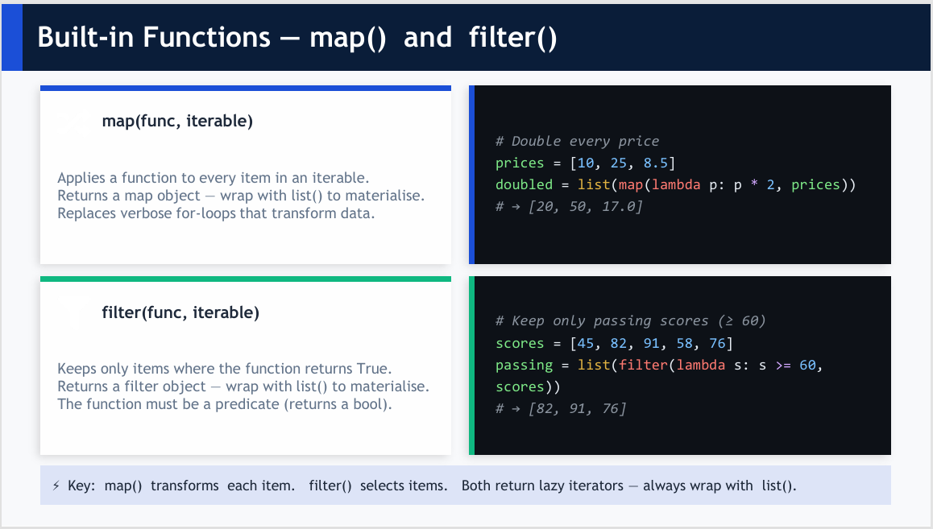
Notes:
Two models with the same accuracy behave very differently in deployment. Why? Distribution shift and variance: Because accuracy is an average, while deployment exposes models to changing data distributions and different levels of variance.

Slide 5
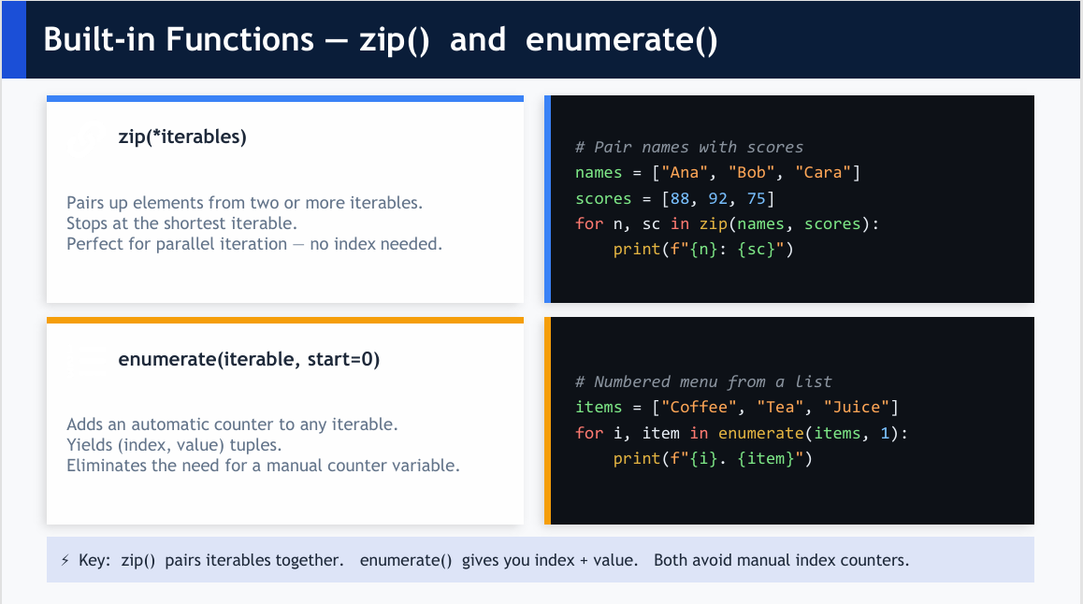

Slide 6


Slide 7
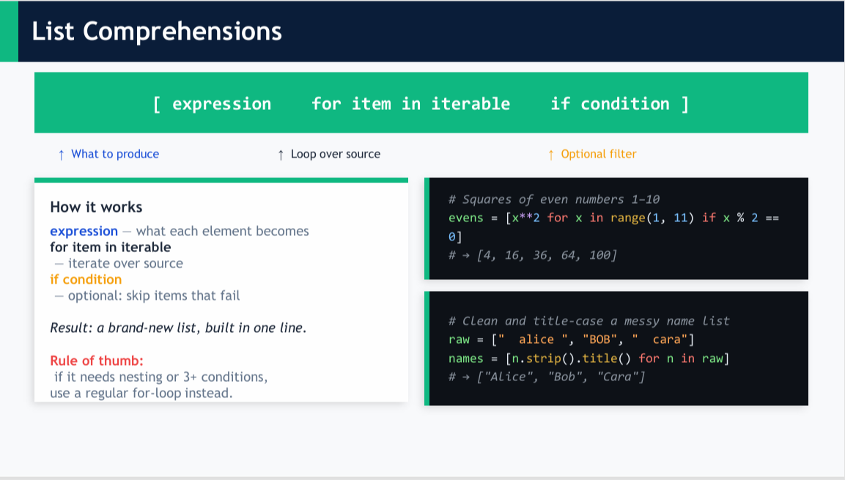

Slide 8


Slide 9
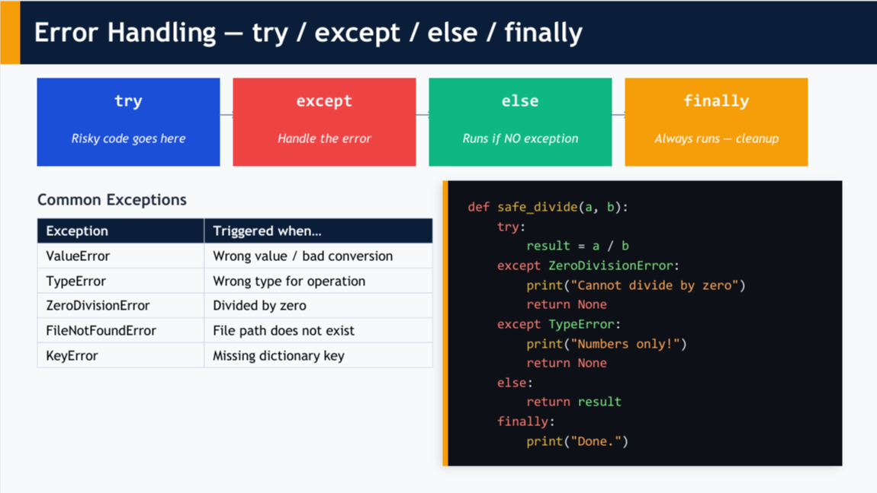

Slide 10


Slide 11
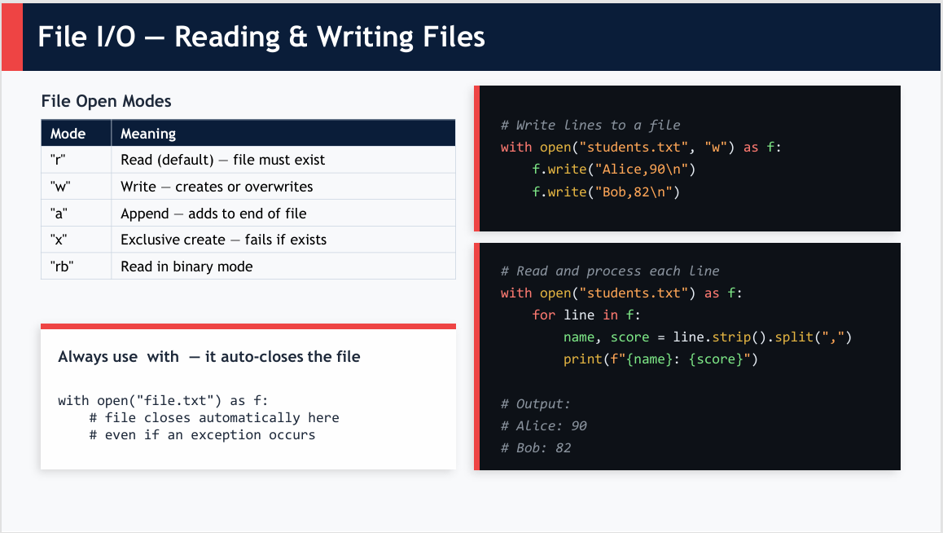

Slide 12


Slide 13
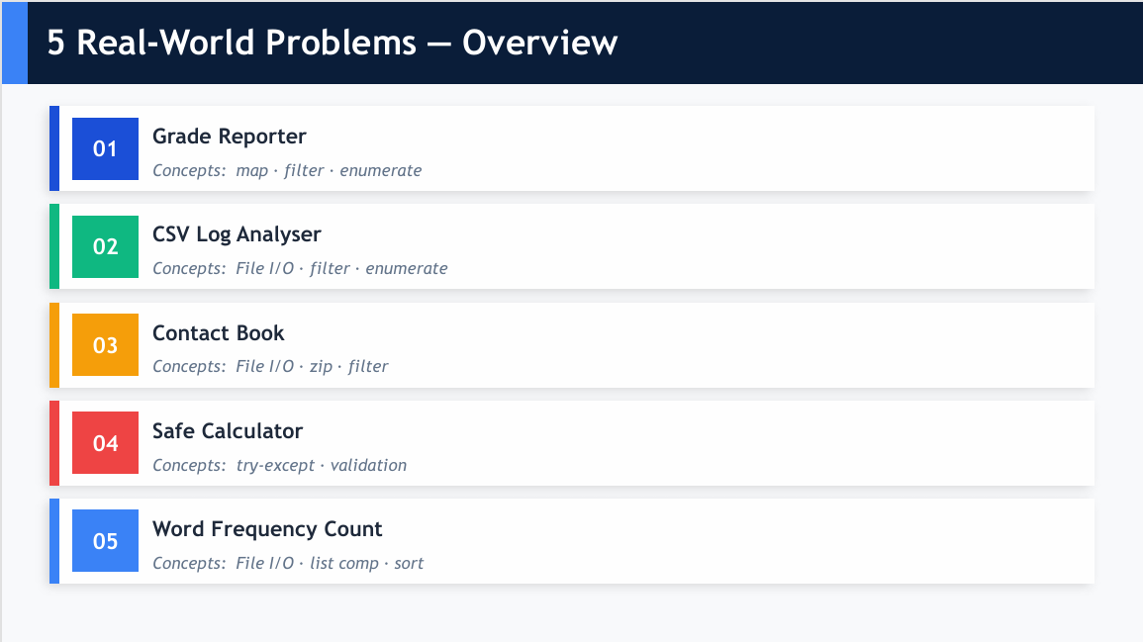

Slide 14
